Slide 1
Cypress
Parameswari E

Slide 2
Goals
Introduction to Cypress
Getting Started
Writing Cypress Tests
Cypress Commands
Working with Data
Page Object Model (POM)
Hooks and Configuration
Test Organizers and Runners

Slide 3
Goals
Continuous Integration (CI)
Advanced Cypress Concepts
Best Practices
Troubleshooting and Debugging
Integration with Other Tools
Security Testing
Performance Testing
Tips for Effective Testing

Slide 4
Introduction to Cypress
Cypress is an open-source, full-featured, and easy-to-use end to end testing framework for web application testing.
Cypress is a relatively new player in the automation testing space.
It has been gaining a lot of traction lately, as evident from the number of Forks (2.2K) and Stars (36.6K) for the project.

Slide 5
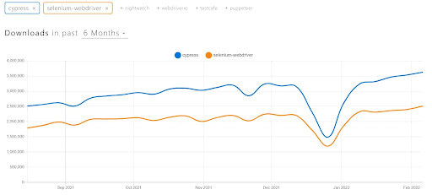
Introduction to Cypress
Cypress is slowly catching up with Selenium.
The six-month download trend comparison of Cypress and Selenium indicates that the war between the two frameworks will continue to intensify in the coming months.

Slide 6
What is Cypress
Cypress is a renowned end-to-end testing framework that enables frontend developers and test automation engineers to perform Web and API testing.
Since it is a JavaScript-based test automation framework, it is widely preferred by the developer community.
Cypress is a testing tool that is targeted toward developers and QA engineers.
It uses a unique DOM manipulation technique and operates directly in the browser.
It supports various browser versions of Google Chrome, Mozilla Firefox, Microsoft Edge(Chromium-based) and Electron.

Slide 7
The Rise of Cypress Framework
Cypress is a comparatively new testing platform that aims to overcome the challenges of automated frontend testing for applications built with React and AngularJS.
It's a quick, easy and reliable tool for testing these applications by running them in their actual browser environments.
Since Cypress executes tests on a real browser instance, we wouldn't need to download browser drivers, unlike Selenium.

Slide 8
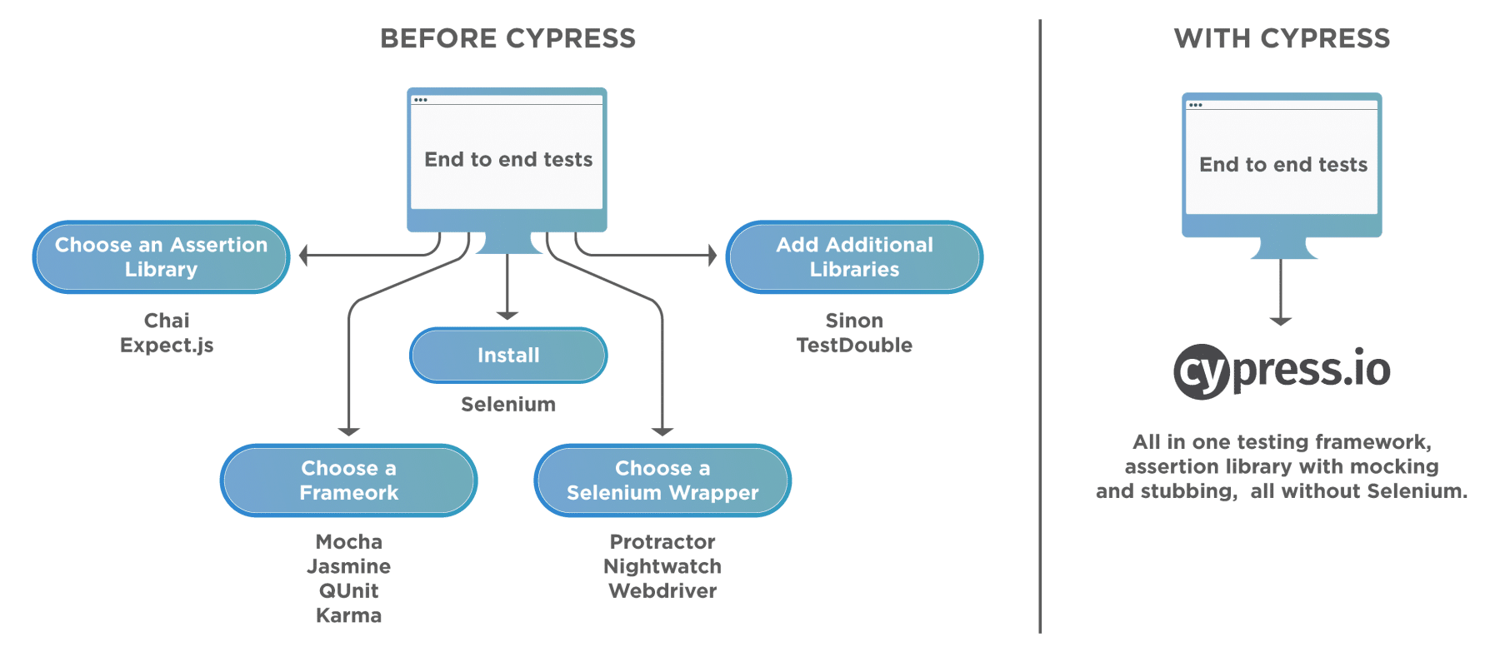
Why Cypress

Slide 9
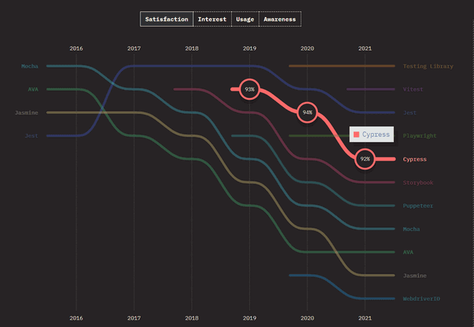
Level of Satisfaction

Slide 10
Why Cypress?
Modern Tool:
Cypress is a Java script-based automation tool that runs in the browser and on Node.js.
It is based on Mocha and Chai and is written in Java script.
This makes Cypress fast and reliable for testing almost every website, those written in Java script.

Slide 11
Why Cypress?
Fast to Setup:
Cypress has no additional requirements for a standard installation.
We do not need any libraries, testing engines, servers, drivers or wrappers.
Cypress doesn’t require configuration or additional choices to be made.

Slide 12
Why Cypress?
Fast to Implement and Debug:
It uses Domain Specific Language that is not pure JavaScript.
Cypress makes it easier for JS developers in the automated testing community to start using the framework.
It is also an approachable tool for experienced QA engineers who are already working with other testing frameworks.

Slide 13
Why Cypress?
Fast to Implement and Debug:
The debugging process in Cypress is streamlined and simple.
With native access to every single object, we can easily analyze errors within your application.
We can debug your application directly with Chrome Dev Tools while the tests are being executed in the browser.

Slide 14
Why Cypress?
Fast to Execute:
Cypress provides a fast, easy, and reliable way to test our application.
It automatically waits for the DOM to be loaded so we don’t have to implement additional waits or set up explicit or implicit waits.
Cypress follows everything that happens in our application synchronously—it knows when the page is being loaded and when elements send events.

Slide 15
Features of Cypress Testing
Cypress gives the ability to capture snapshots during a test run.
Hovering over a command in the Command Log displays an event summary that describes each event in a test step.
Cypress enables easy debugging from the Developer Tools.
Errors are displayed, and stack traces are available for each error.
Cypress ensures that synchronization techniques like sleep and wait are unnecessary in test cases.
Instead, it waits for actions and checks before proceeding ahead.

Slide 16
Features of Cypress Testing
Cypress ensures the characteristics of the functions, timers, and server responses.
This is critical from a unit testing point of view.
Cypress can capture a screenshot of the browser window on failure by default.
It also records a video of your entire test suite execution running from its command-line interface.
Because of its architectural design, Cypress provides quick, steady, and dependable test execution results compared to other tools in automation.

Slide 17
Features of Cypress Testing
Cypress has a good error logging message that describes why our script failed.
Cypress has an easy-to-use API and requires no configuration to start with.
Cypress supports only JavaScript which makes it a preferred choice for developers as well.
However, this adds to the learning curve for testers or developers who aren’t familiar with JavaScript.

Slide 18
Cypress Drawbacks
Requires compulsory installation of NPM packages as it is limited to JavaScript only.
Does not support multiple tabs while running tests.
Does not support a very broad range of browsers like Selenium WebDriver does.
Sole reliance on JavaScript multiplies syntax complexities.
Cypress community is not that large and there are not many cypress experts who can help you out with complex issues.

Slide 19
Cypress Architecture
Cypress tests run inside the browser.
It allows Cypress to modify the browser's behavior by listening to the incoming network requests and altering them on the fly.
In addition, cypress tests have a lower flakiness rate than Selenium tests since Cypress does not use WebDriver.
Instead, spies and stubs can be used at run time to control the behavior of functions and times.

Slide 20
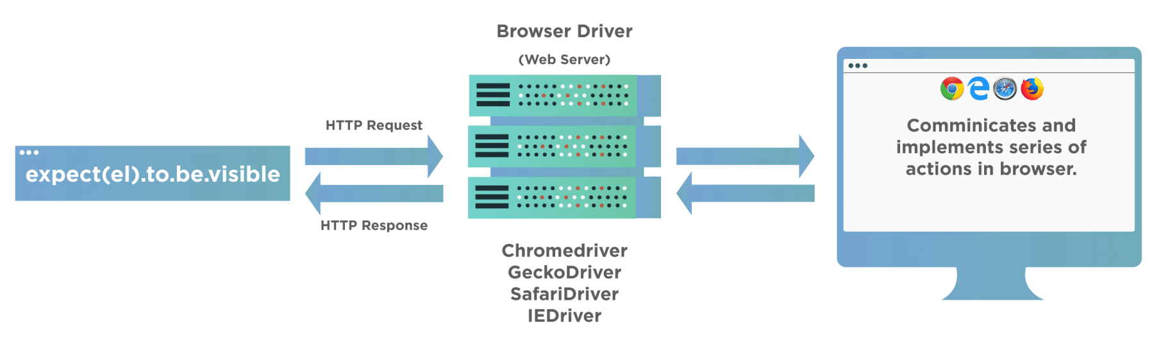
Cypress Architecture

Slide 21
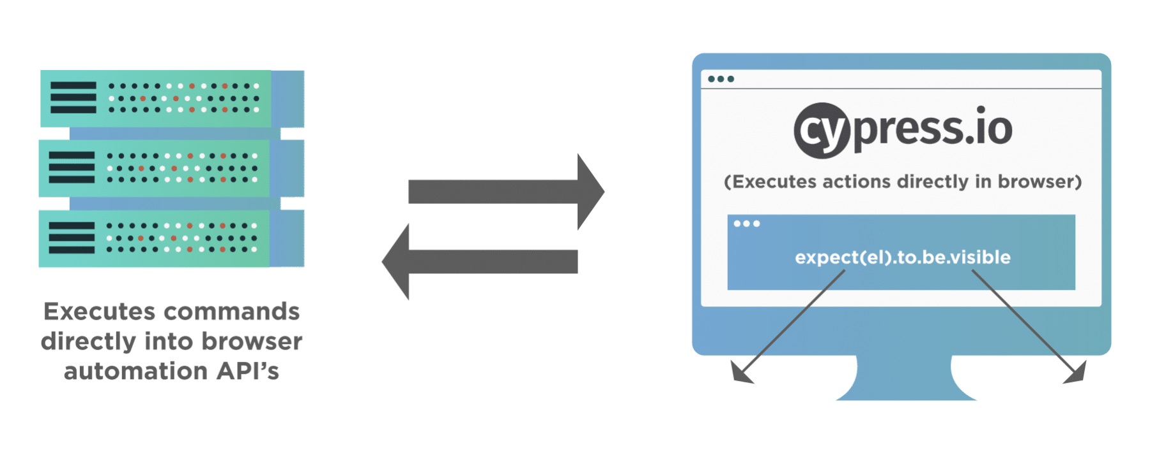
Cypress Architecture

Slide 22
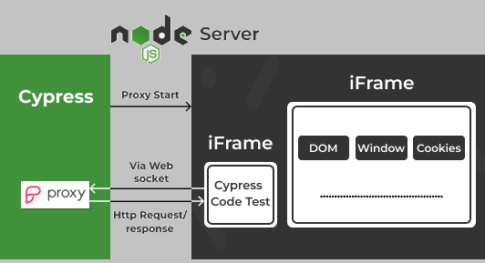
Cypress Architecture

Slide 23
Cypress Architecture
Cypress executes on a NodeJS server that invokes the tested browser for running Cypress tests, which are encapsulated in another iFrame.
This can be accomplished by running both the Cypress and NodeJS processes on the same session, thereby allowing Cypress to mock JavaScript global objects.
In addition, NodeJS's running process also acts as a proxy that helps intercept HTTP requests, helping Cypress mock these requests during testing.
Cypress supports Chrome-family browsers (including Electron and Chromium-based Microsoft Edge) and Firefox.

Slide 24
Browsers Supported by Cypress
Chrome
Chrome Beta
Chrome Canary
Chromium
Edge
Edge Beta
Edge Canary
Edge Dev
Electron

Slide 25
Browsers Supported by Cypress
Chrome
Chrome Beta
Chrome Canary
Chromium
Edge
Edge Beta
Edge Canary
Edge Dev
Electron Firefox
Firefox Developer Edition
Firefox Nightly

Slide 26
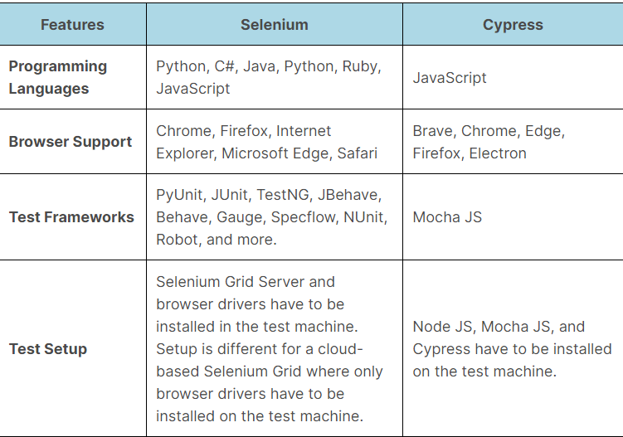
Selenium vs Cypress

Slide 27
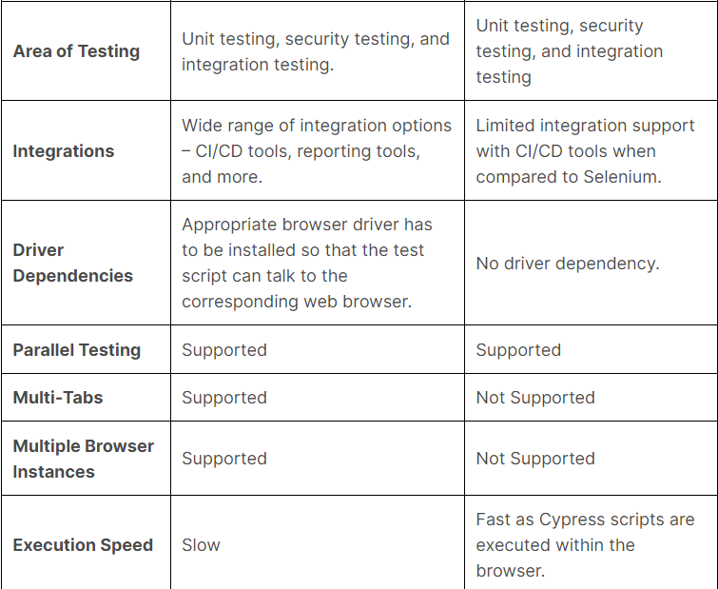
Selenium vs Cypress

Slide 28
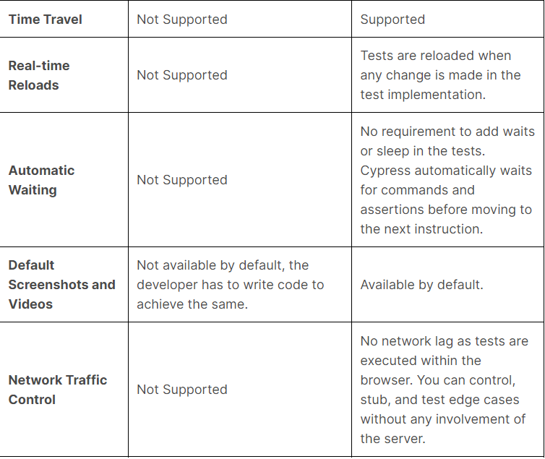
Selenium vs Cypress

Slide 29
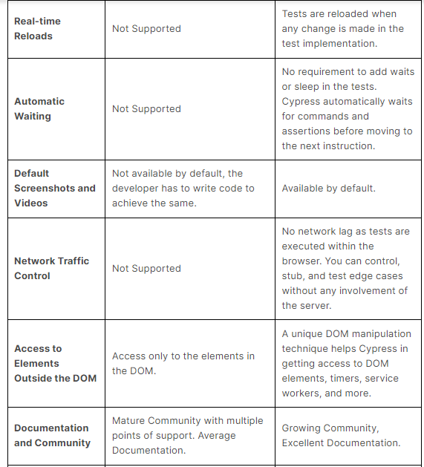
Selenium vs Cypress

Slide 30
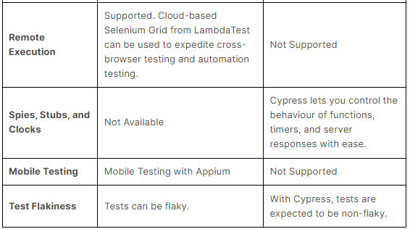
Selenium vs Cypress

Slide 31
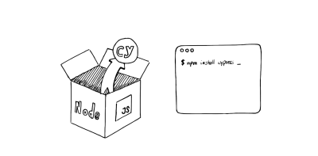
Cypress Installation

Slide 32
Cypress Installation
npm install -g cypress
cypress open
(or)
npx cypress open
React cypress
Go to project folder
npm install --save-dev cypress

Slide 33
Cypress Installation
mkdir cypress
cd cypress
mkdir integrations
cd integrations
Go to package.json
add the following in scripts
"test:cypress": "cypress open",
then run cypress test
yarn test:cypress
To run cypress test from console
npx cypress run --browser chrome --spec './cypress/e2e/reactdemo.cy.js'

Slide 34
What are the components of Cypress?
It has two main components that come by default in its installation - Cypress Test Runner and Cypress Dashboard.
One of them is used as a runner to run our Cypress test cases on the local machine, and the other tracks our runs and status from our Automation Suite.

Slide 35
What are the components of Cypress?
It has two main components that come by default in its installation - Cypress Test Runner and Cypress Dashboard.
One of them is used as a runner to run our Cypress test cases on the local machine, and the other tracks our runs and status from our Automation Suite.
Test Runner: It runs tests in a unique interactive runner that allows us to see commands as they execute while also viewing the application under test.

Slide 36
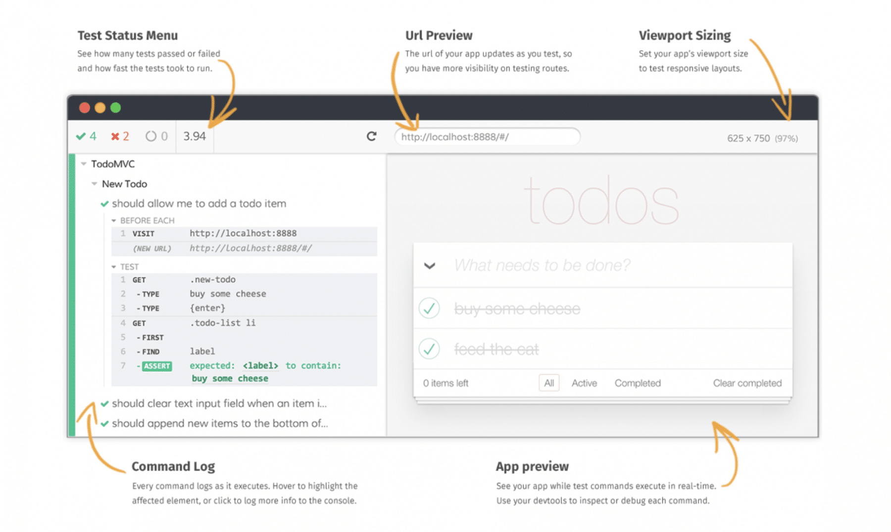
What are the components of Cypress?

Slide 37
What are the components of Cypress?
Test Status: Menu shows you a summary of how many tests passed, failed, or in progress and time took for the test.
Url Preview shows the URL of our test and helps you track any URL route.
Viewport Sizing: set our app viewport size to test responsive layouts.
Command Log: It shows the command logs as it executes for all the tests that execute.
App Preview: we can see the test while commands execute.

Slide 38
What are the components of Cypress?
Test Status: Menu shows you a summary of how many tests passed, failed, or in progress and time took for the test.
Url Preview shows the URL of our test and helps you track any URL route.
Viewport Sizing: set our app viewport size to test responsive layouts.
Command Log: It shows the command logs as it executes for all the tests that execute.
App Preview: we can see the test while commands execute.

Slide 39
What are the basic Constructs of Cypress
Cypress has adopted Mocha’s syntax for the development of test cases, and it uses all the fundamental harness that Mocha provides.
Below are a few of the main constructs which we majorly use in Cypress test development:
describe(): It is simply a way to group our tests. It takes two arguments, the first is the name of the test group, and the second is a callback function.
context(): It is just an alias for describe().
it(): We use it for an individual test case. It takes two arguments, a string explaining what the test should do, and a callback function which contains our actual test.
before(): It runs once before all tests in the block.

Slide 40
What are the basic Constructs of Cypress
after(): It runs once after all tests in the block.
beforeEach(): It runs before each test in the block.
afterEach(): It runs after each test in the block.
.only(): To run a specified suite or test, append ".only" to the function.
.skip(): To skip a specified suite or test, append ".skip()" to the function.

Slide 41
How to write a Cypress Test Case?
Each test generally consists of three steps:
Prerequisite: You have a given state of the application.
Action: You perform some action on the elements of the application.
Expectations: Then, you assert/validate the changed state of the application.

Slide 42
How to write a Cypress Test Case?
Each test generally consists of three steps:
Prerequisite: You have a given state of the application.
Action: You perform some action on the elements of the application.
Expectations: Then, you assert/validate the changed state of the application.

Slide 43
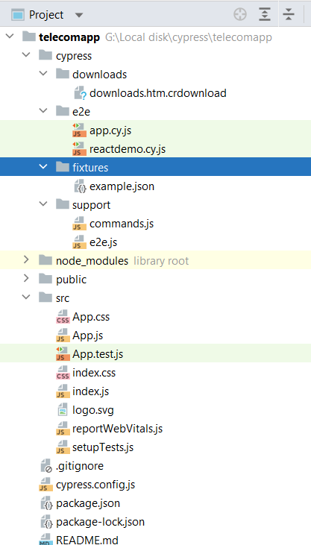
How to write a Cypress Test Case?

Slide 44
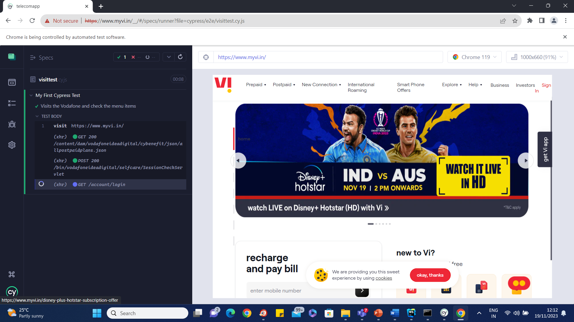
How to write a Cypress Test Case?

Slide 45
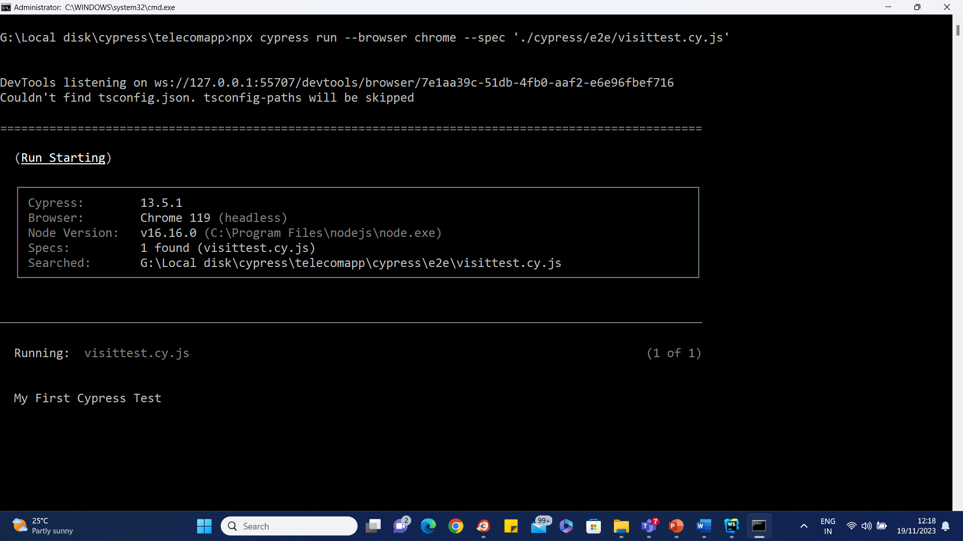
How to Run Cypress Test Case from Console

Slide 46
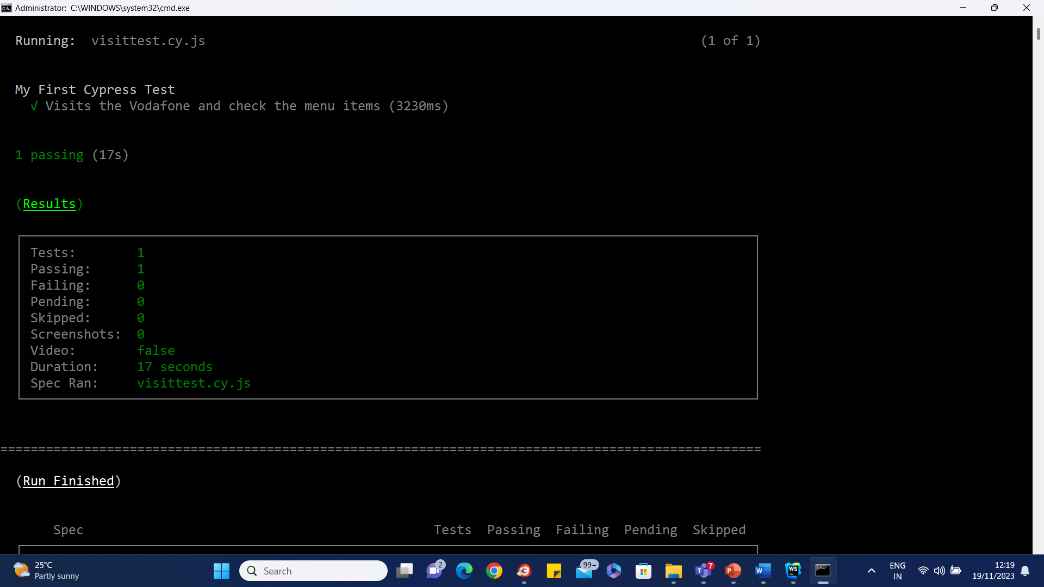
How to Run Cypress Test Case from Console

Slide 47
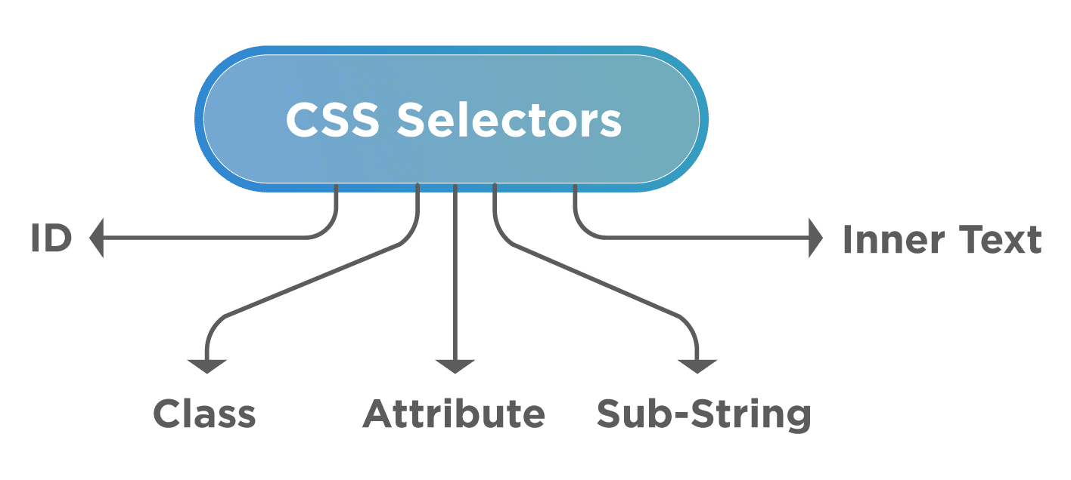
Cypress Locators

Slide 48
Cypress and xpath
npm install -D cypress-xpath
yarn add @cypress/xpath –save-dev
Import cypress xpath in test file
import "cypress-xpath“

Slide 49
Assertions
Cypress bundles the popular Chai assertion library, as well as helpful extensions for Sinon and jQuery.
It gives dozens of powerful assertions for free.

Slide 50
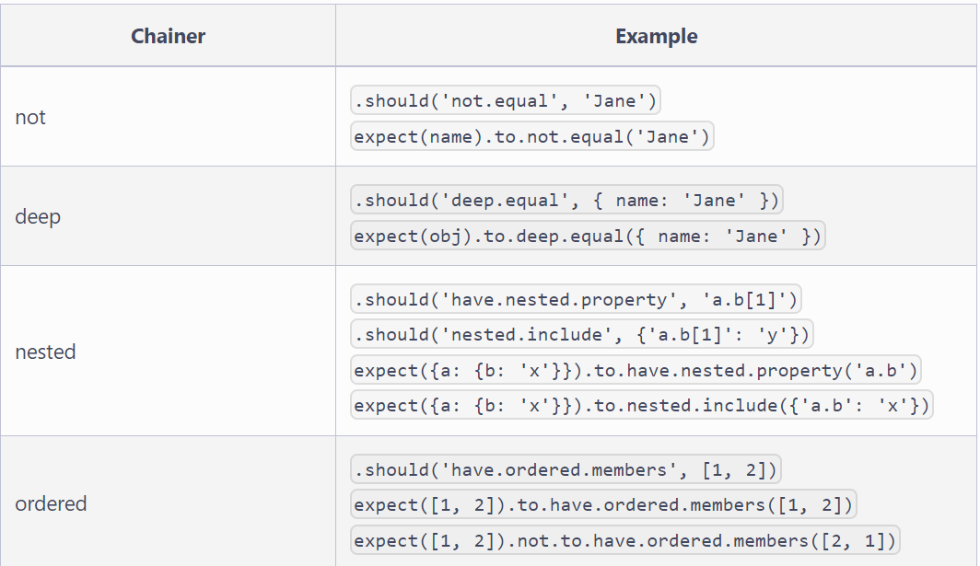
Assertions

Slide 51
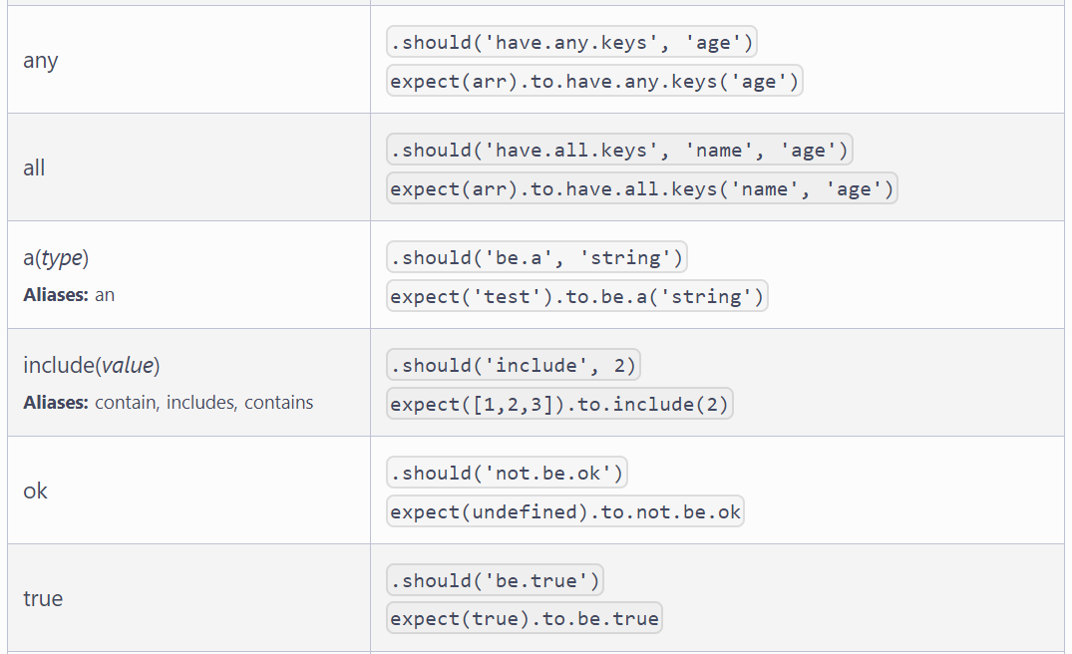
Assertions

Slide 52
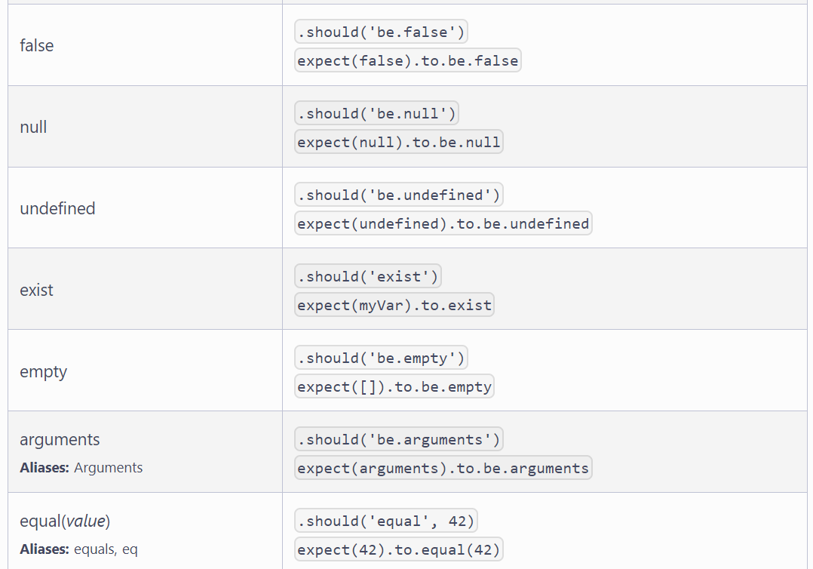
Assertions

Slide 53
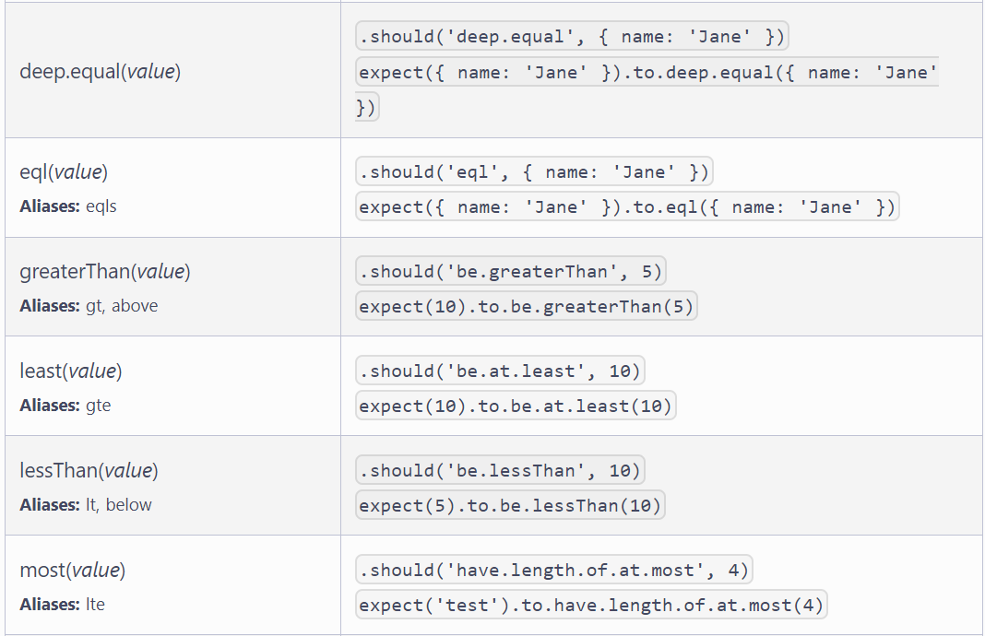
Assertions

Slide 54
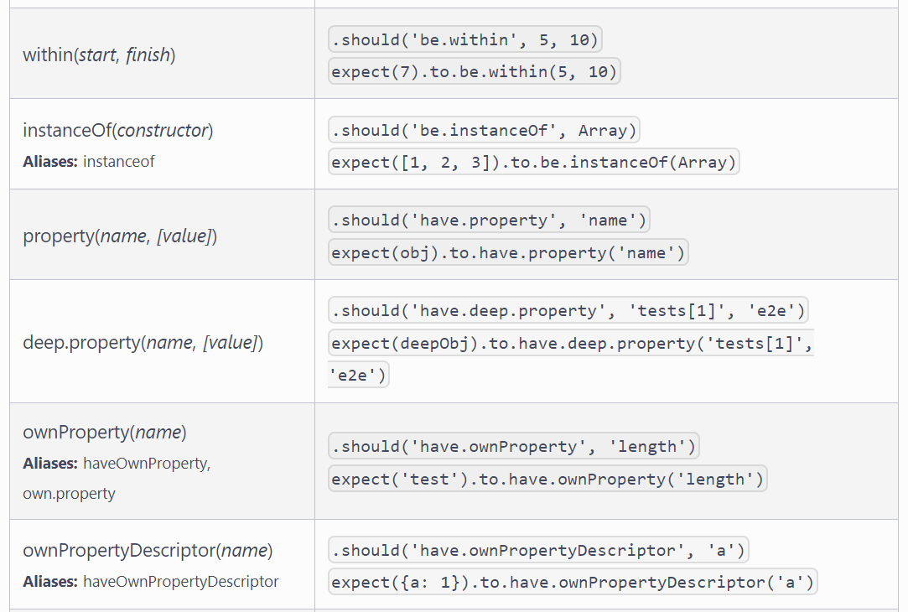
Assertions

Slide 55
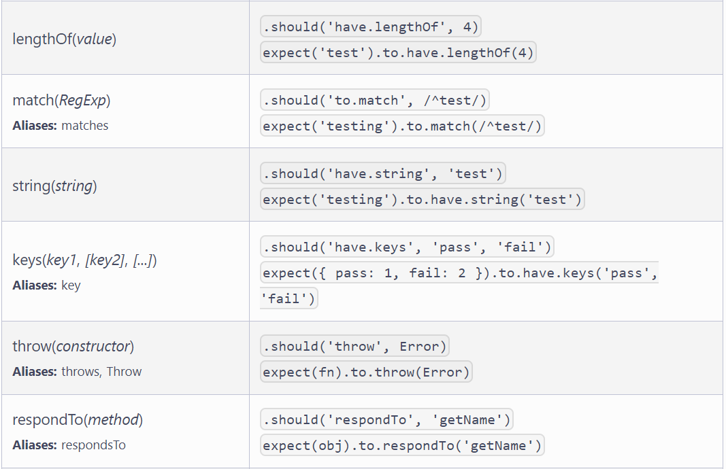
Assertions

Slide 56
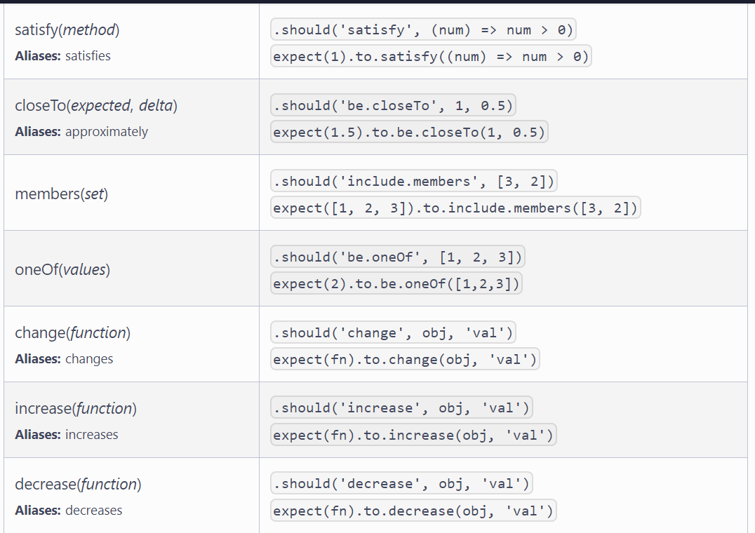
Assertions

Slide 57
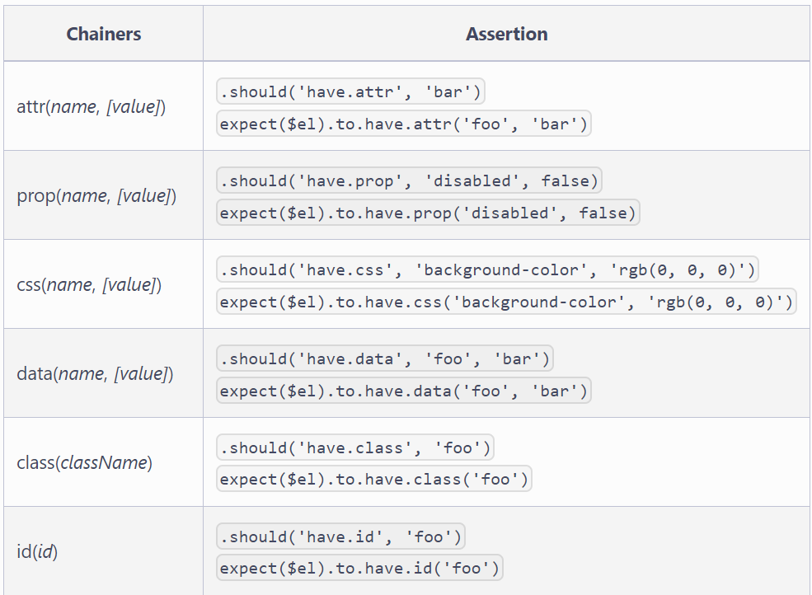
Chai Jquery

Slide 58
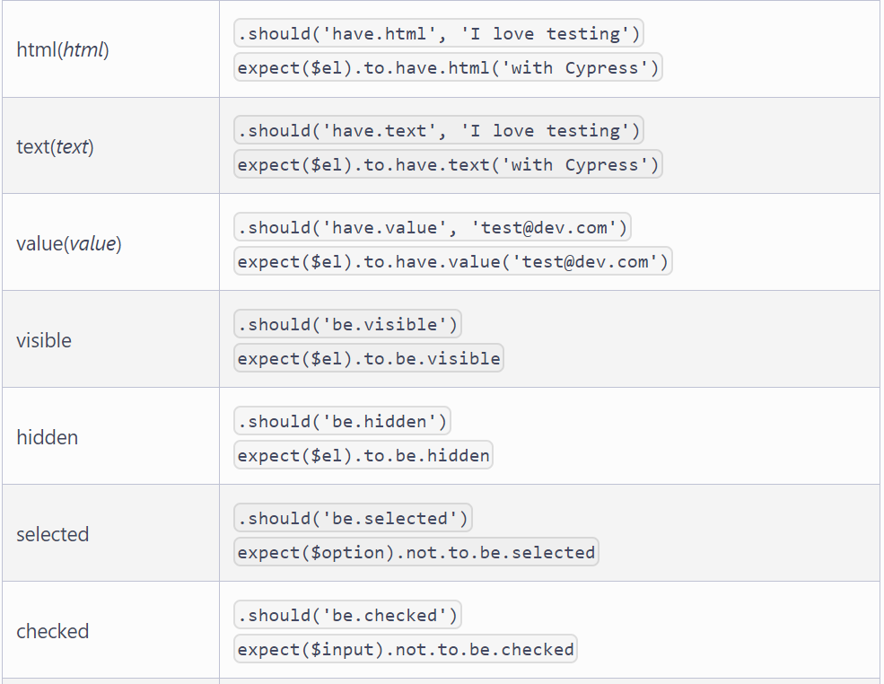
Chai Jquery

Slide 59
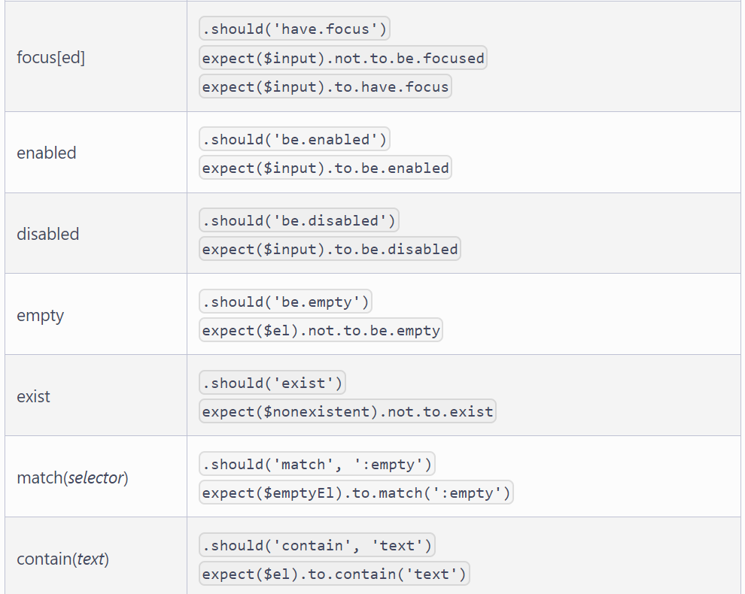
Chai Jquery

Slide 60
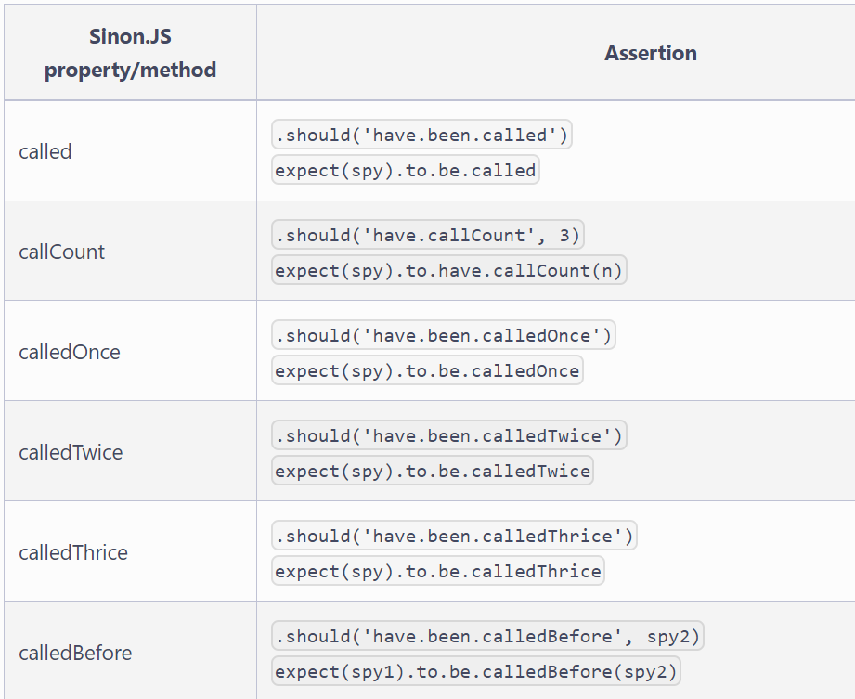
Shan Chai

Slide 61
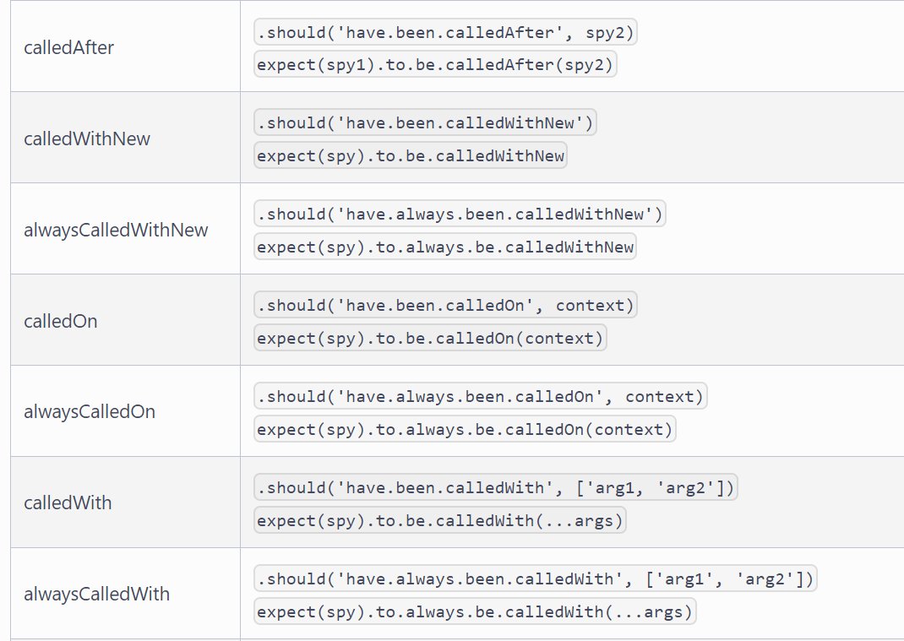
Shan Chai

Slide 62
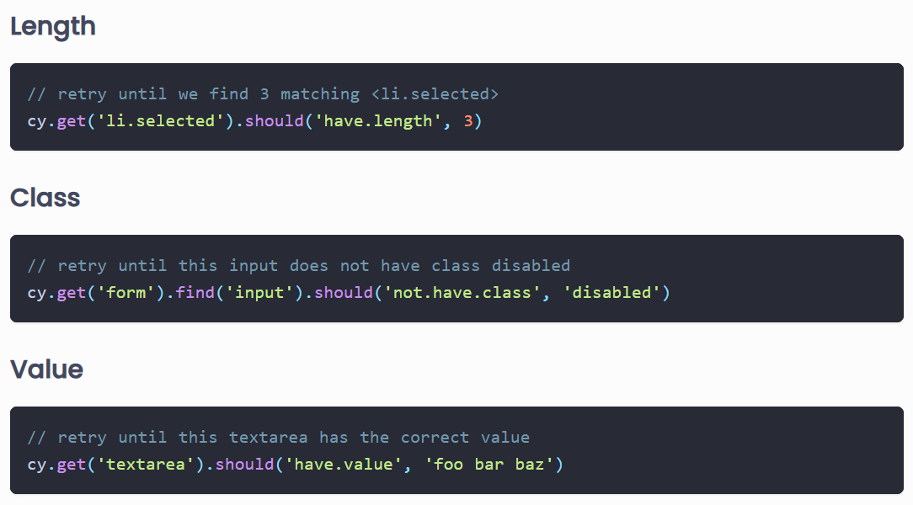
Assertions

Slide 63
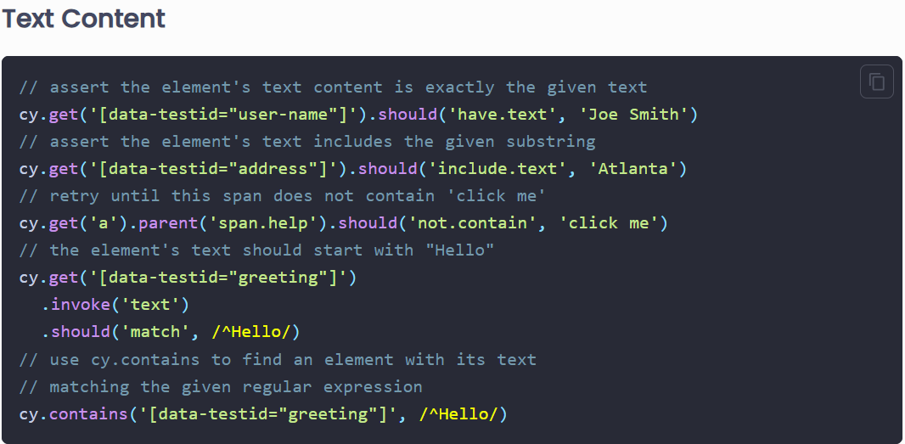
Assertions

Slide 64
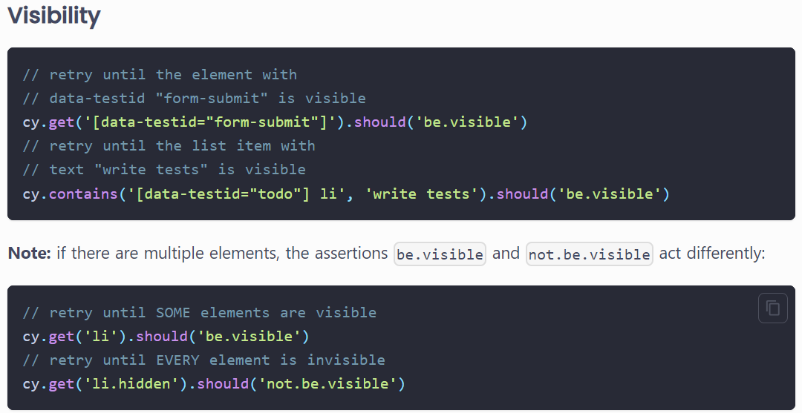
Assertions

Slide 65
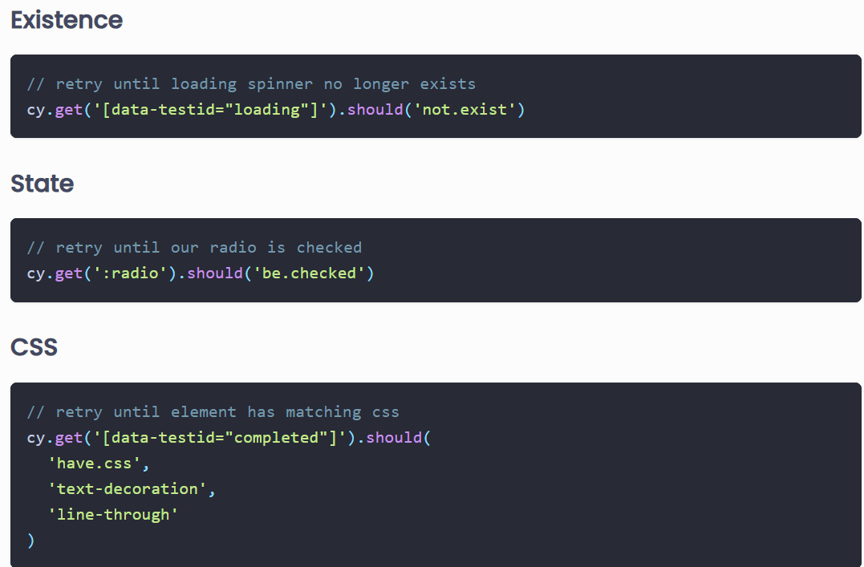
Assertions

Slide 66
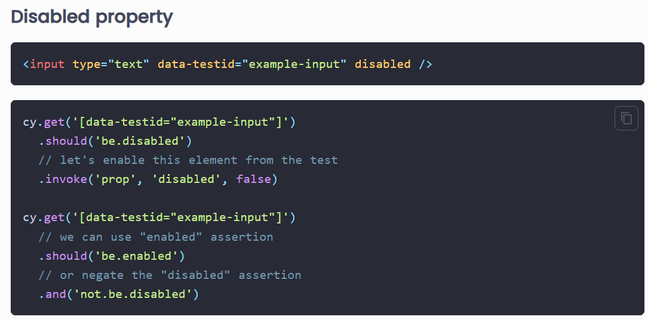
Assertions

Slide 67
Iframe
npm install -D cypress-iframe --save-dev
import 'cypress-iframe’

Slide 68
Popup

Slide 69
Basic commands used in cypress
‘and’ command in cypress
‘as’ command in cypress
‘blur ‘command in cypress
‘check’ command in cypress
‘select’ command in cypress
‘children’ command in cypress
‘clear’ command in cypress
‘clearcookies’ command in cypress
‘getcookies’ command in cypress
‘clearLocalStorage’ command in cypress
‘click’ in cypress
‘contains’ command in cypress
‘dblclick’ command in cypress
‘each’ in cypress

Slide 70
Basic commands used in cypress
‘eq’ in cypress
‘exec’ command in cypress
‘get’ command in cypress
‘find’ command in cypress
‘first’ command in cypress
‘go’ command in cypress
‘visit’ command in cypress
‘next’ command in cypress
‘parent’ command in cypress
‘should’ command in cypress
‘wait’ command in cypress
‘title’ command in cypress
‘viewport’ command in cypress
‘log’ command in cypress

Slide 71
Interacting with Elements
Actionability
.click()
.dblclick()
.rightclick()
.type()
.clear()
.check()
.uncheck()
.select()
.trigger()

Slide 72
Interacting with Elements
cy.get('button').click();
cy.get('.element').dblclick();
cy.get('#element').rightclick();
cy.get('input[name="username"]').type('JohnDoe’);
cy.get('input[name="username"]').clear();
cy.get('input[type="checkbox"]').check();
cy.get('select[name="country"]').select('USA’);
cy.get('.element').trigger('mouseover’);

Slide 73
Handling Data in Fixtures

Slide 74
Excel Data Fixture
npm install node-xlsx --save-dev

Slide 75
Page Object Model
The Page Object Model (POM) is a design pattern used in software development where classes represent pages.
POM can make code more maintainable and reduce duplication.
All page elements are stored in that class for the related page.
This makes it easy to access and update page elements as needed, especially when there are changes in the front end (or UI) of the website.
Page Object Model also makes it easy to reuse code, which can save time and money when testing web applications.

Slide 76
Advantages of POM
The Cypress Page Objects Model offers a high level of abstraction.
This means that tests can be written without having low-level details of the implementation.
This makes it easier to write maintainable and robust tests.
The Cypress Page Objects Model improves readability.
It can make tests more readable and easier to understand by segregating the page logic from the test logic, making it easier for new team members to understand the test suite.

Slide 77
Advantages of POM
It helps improve code efficiency.
Because Cypress Page Object Model offers a higher level of abstraction, they can save time when tests are being written by developers.
It is an elegant way to keep your test cases maintainable if some of your element selectors change in the future.
We will only have to fix the selectors in that specific page object file without updating the selectors in every test file in which the element is used.

Slide 78
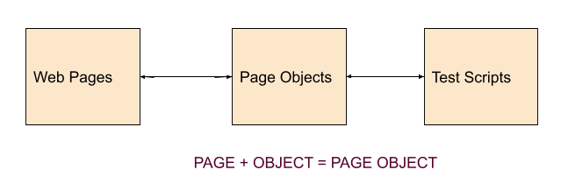
POM

Slide 79
Cypress Jenkins
Refer Free Style Project cypressnodejs

Slide 80
Cypress Cucumber
npm install @badeball/cypress-cucumber-preprocessor
npm install @cypress/browserify-preprocessor
yarn add cypress-cucumber-preprocessor@4.3.1
Create cucumber files
Modify package.json
Modify cypress config file
npx cypress run --env tags="@Smoke"

Slide 81
Cypress Allure
https://kailash-pathak.medium.com/how-to-integrate-allure-report-in-cypress-2224f4ae815

Slide 82
Questions

Slide 83
Module Summary
E2E Testing
Cypress Testing

